Slide 1
Key Insights, Graphs & Conclusions
E-commerce Sales Data Analysis
Topics covered
FINANCIAL PERFORMANCE
CUSTOMER INSIGHTS
LOGISTICS & FULFILLMENT
PRODUCT MANAGEMENT
CUSTOMER SATISFACTION

Slide 2
Problem Statement:
The e-commerce company is facing multiple
operational challenges that hinder growth and
customer satisfaction & to address these issues, the company is
leveraging data-driven insights to optimize
operations.
Dataset provided is sales data.csv with columns like
Order ID, Date, Status, Fulfilment, Sales Channel, ship-service-level, Style,
SKU, Category, Size, Quantity, currency, Amount, ship-city, ship-state, ship-country, ship-postal-code, promotion_ids, B2B, fulfilled_by
Dataset Overview
• Total Orders: 1,20,352
• Cancelled Orders: 19,188
• Overall Cancellation %: 16%

Slide 3
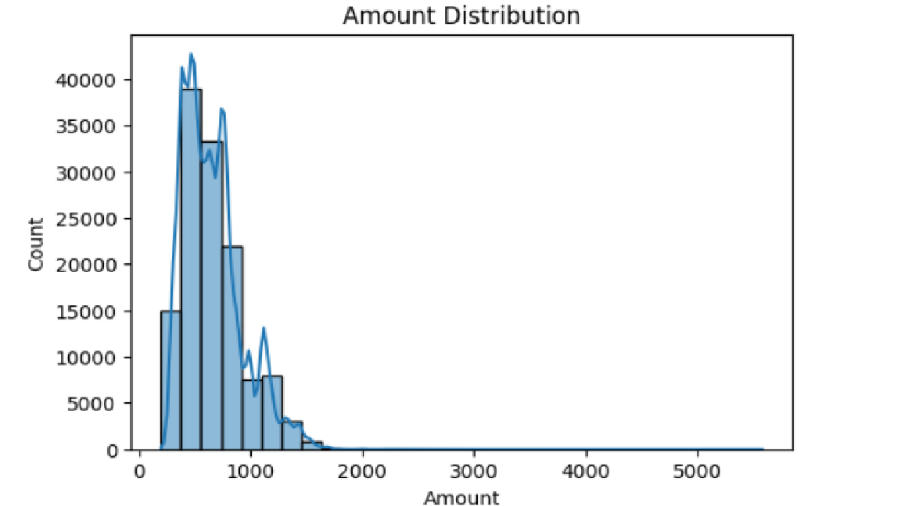
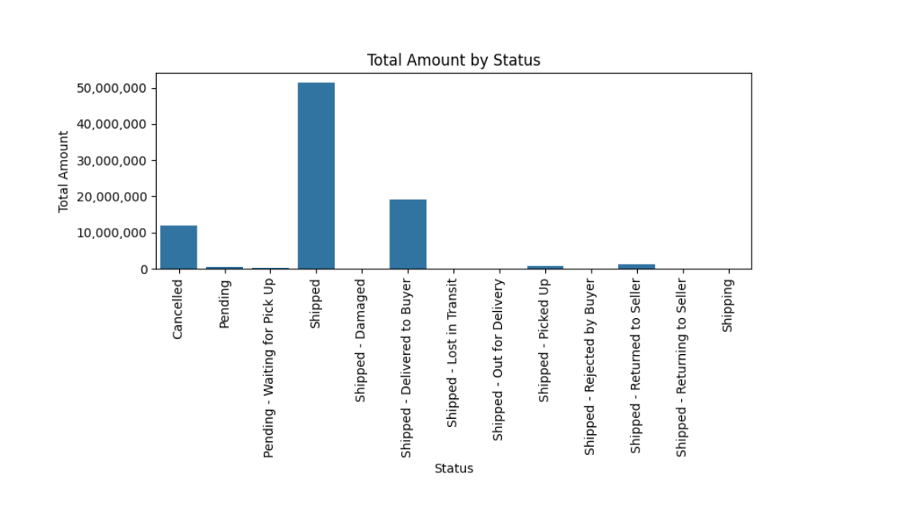
FINANCIAL PERFORMANCE
The histogram shows that most customers place orders in the ₹250–₹1,000 range, with some customers placing orders exceeding ₹3,000.
Most customers accepted the delivery rather than canceling their orders.
Orders are primarily fulfilled by Amazon, followed by the Expedited fulfillment facility.
Sets and kurtas are the most frequently ordered items.
Size M is the most ordered size, indicating a higher proportion of customers preferring
this size.
The highest number of orders originate from Maharashtra, Karnataka, and Tamil Nadu.

Slide 4
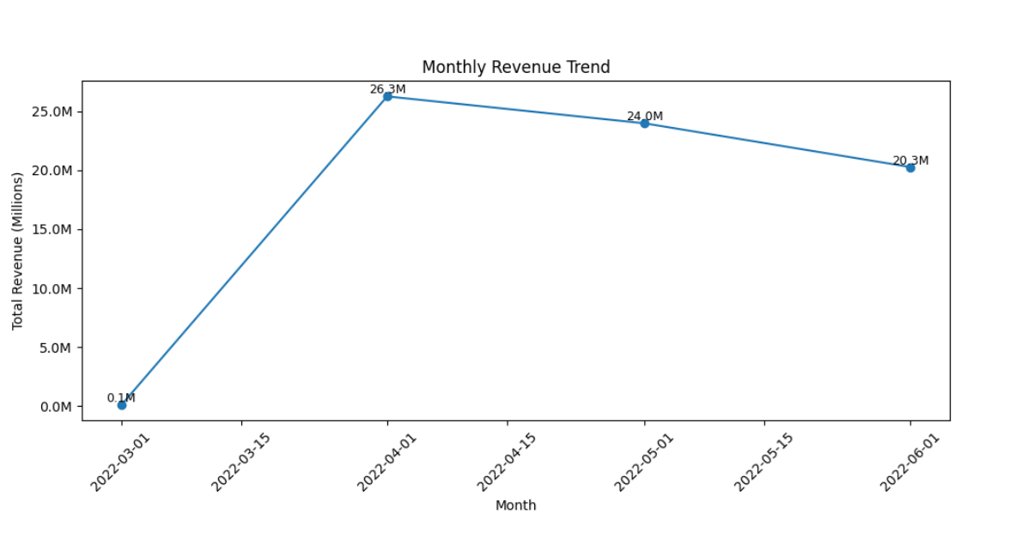
For this analysis, realized revenue is defined as orders with status “Shipped – Delivered to Buyer” and “Shipped”; it peaks at ₹26M in April and declines in the subsequent months.
The value of canceled orders decreased from ₹5M in April to ₹4M in May and ₹3.8M in June.
Orders in process, defined as statuses “Shipped – Lost in Transit,” “Shipped – Out for Delivery,” “Shipped – Picked Up,” “Pending,” “Pending – Waiting for Pick Up,” “Shipped – Damaged,” and “Shipping,” amount to ₹18K in April and May, rising sharply to ₹1.3M in June.

Slide 5
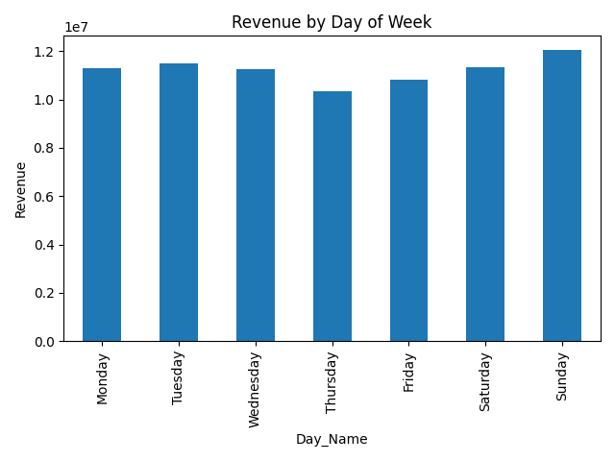
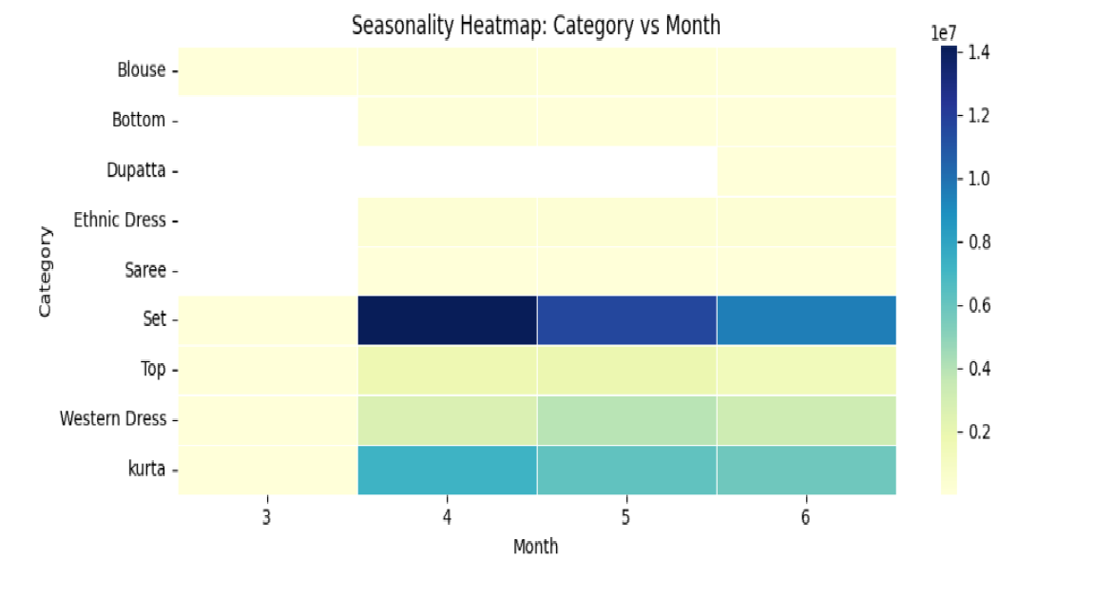
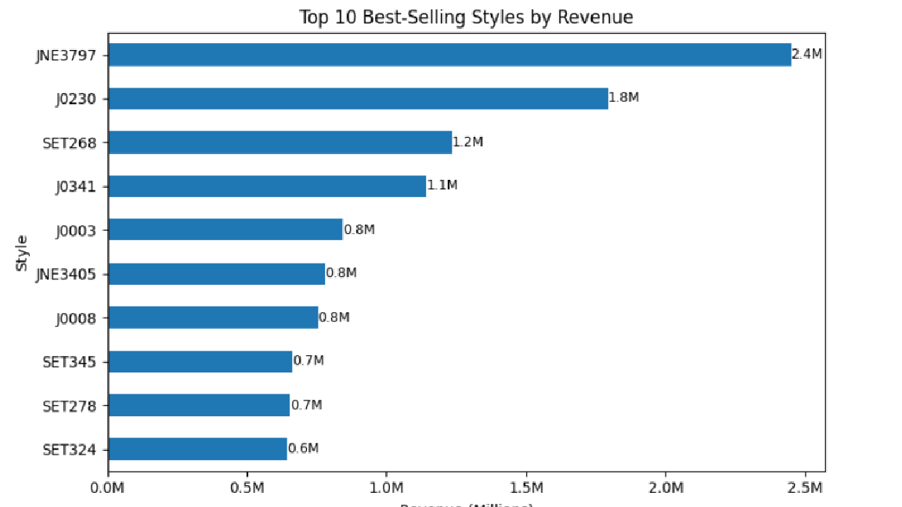
Revenue by Day of Week
Revenue is highest on Sundays relative to the rest of the week.
JNE3797, J0230, SET268 are top 3 styles generating revenue of 2.4m, 1.8m, 1.2m.
Most ordered category is SET in Apr, May, Jun followed by kurta

Slide 6
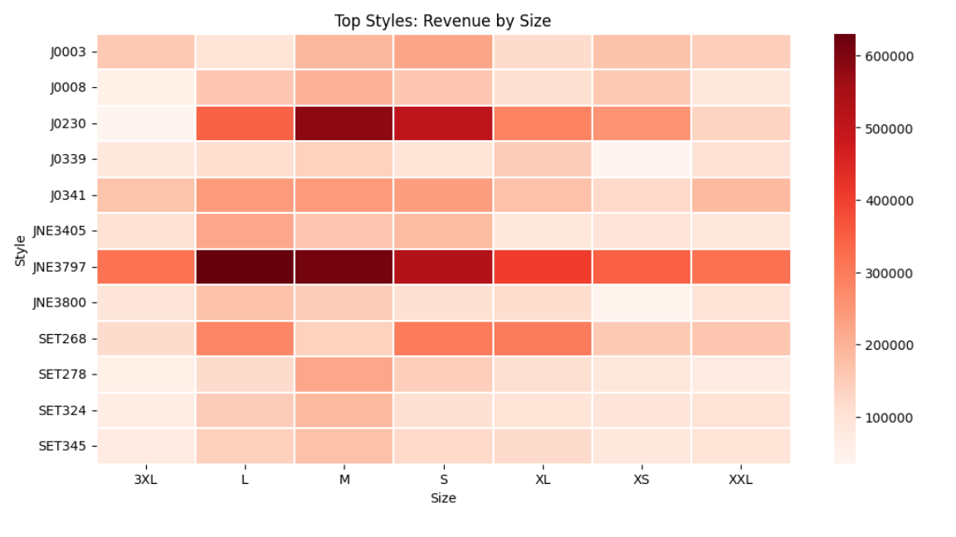
Customer Insights
JNE3797 in sizes S, M, L, and XL is the most liked style, followed by J0230.
The most cancelled categories are Set (16%), Kurta (16%), and Western Dress (15%).
In terms of volume, the most cancelled sizes are XS (18%), S (16%), M (16%), and L (15%), while 6XL, 5XL, and 4XL show the highest cancellation rates (>75%).
Fulfilled by Amazon orders have a 12% cancellation rate, compared to 22% for Merchant-fulfilled orders.
The Average Order Value (AOV) is higher for B2B (₹703) than for B2C (₹660).

Slide 7
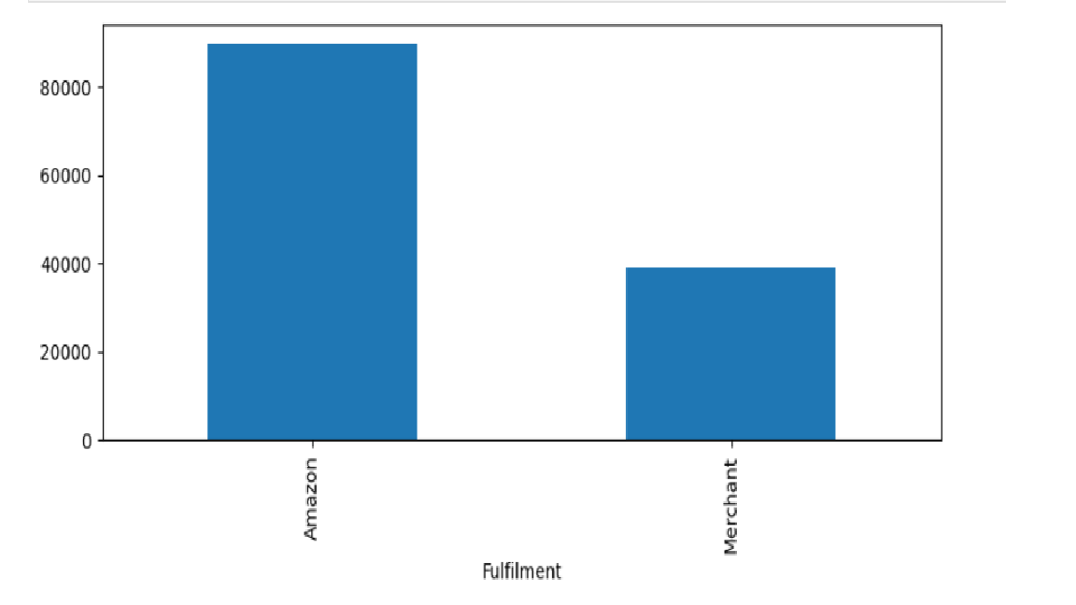
Logistic & Fulfilment Optimization
Amazon-fulfilled orders show a higher success rate (86%) compared to Merchant-fulfilled orders (73%), with 0.4% and 4% of orders respectively still in process.
A total of 89,672 orders are fulfilled by Amazon, while 39,270 orders are fulfilled by Merchants.
The Average Order Value (AOV) is nearly identical for both Amazon- and Merchant-fulfilled orders.
This indicates that fulfilment choice significantly impacts realized revenue, with Amazon being more reliable than merchant fulfilment.

Slide 8
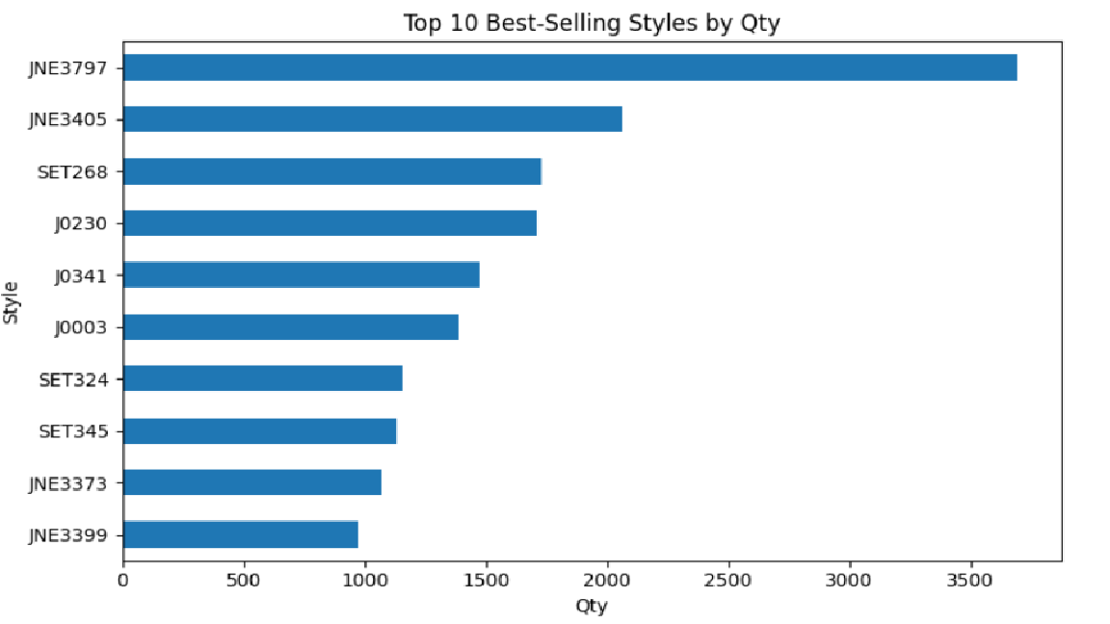
PRODUCT MANAGEMENT & INVENTORY OPTIMIZATION
Top 3 styles sold the most by quantities are JNE3797,JNE3405,SET268 indicating high demand product.
Avg order qty for styles BL017,BL020 of category Blouse is 2, whereas for other categories like saree, set etc is 1.
AN201,AN202,AN203,AN204,AN205 are slow movers which has very less demand which indicates overstock risk.
Most successful category of order fulfilment is Dupatta with 100% successful order without return or cancellation.
SET195, JNE3475, JNE3608 are most cancelled products.

Slide 9
Conclusion & Recommendations
Strengthen weekend promotions.
Improve fulfilment to reduce cancellations.
Align inventory with demand patterns.
Use insights for data-driven decisions.
Improve product quality checks, fit, or expectation mismatch for High-return categories as these categories require priority intervention.
Update size charts & visuals.
Pause promotions, review supplier for Problematic styles.
Enforce stricter SLAs for Merchant fulfilment.
Improve descriptions & reviews for Low-confidence orders.

Slide 10
Thank You

